Slide 1
API Management
March 28, 2019 — 8:30 AM - 5:00 PM | Detroit, Michigan
Learn, architect, and develop solutions on Azure
#AzureDevDays
for developers, by developers
Learn.
Connect.
Explore.

Slide 2






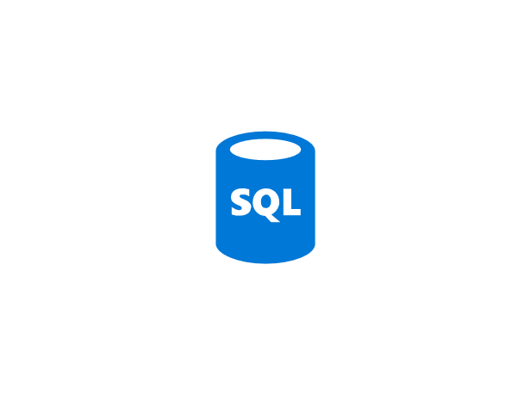


APIs: Connecting applications
Customers, partners & developers
Web, mobile, devices & 3rd party integrations
Application Programming Interface (API)
Internal data, applications & algorithms
Notes:
An API allows two or more software applications to talk to each other. One application “hosts” the API, the other application “calls” the API and gets a response.
A big advantage of this approach is that you can provide 3rd parties – customers, partners and developers - access to your functionality and data to integrate into their web and mobile applications without needing to give them a copy of your internal IP. The API acts as a façade, controlling what is exposed and how it can be accessed.
Additionally, you can use APIs to separate, protect and reuse business logic and data for your own internal and external web and mobile applications.
APIs are everywhere. Everyday actions — like posting a message on a social network, reading the news on a smartphone, or buying a cinema ticket online — are all completed through API calls.

Slide 3




Benefits of APIs
Expand
market reach
Foster
innovation
Lower
TCO
Highly scalable
business models
Notes:
APIs provide many benefits to organisations which can be summarised under these four pillars:
Expand market reach: APIs enable partner ecosystems and coopetition, allowing organizations to reach new audiences and niches
Foster innovation: APIs can be leveraged in new and unexpected ways by developers, creating disruptive business models
Lower TCO: APIs are a cost effective way of providing support across many devices, operating systems & development languages
Highly scalable business models: well-designed APIs, hosted on cloud platforms, can scale to support global businesses

Slide 4
APIs: Internal architecture for the Enterprise
Maximise IP Reuse
Accelerate Development
Consistency of Information
Control Access
Intrapreneurship
Inside-out transformation
Notes:
APIs should not only be considered as externally facing. Companies that expose APIs internally can make it easier for different parts of the organization to benefit from each other’s data and applications. e.g.
Maximise IP reuse: Increase efficiencies in maintenance, support and development of core services by exposing as APIs
Accelerate development: Increase speed of development of new products and services by using APIs as building blocks of common functionality e.g. payment processing, email sending, address lookups, single sign on
Consistency of information: Ensure data is accurate and consistent wherever it is used across the organisation by exposing it through central APIs, rather than sharing and duplicating spreadsheets, or maintaining disparate and inconsistent repositories of information
Control access: By only supporting services and data through APIs (rather than ad-hoc and uncontrolled requests for information), access and permissions can be controlled, monitored and audited centrally.
Intrapreneurship: Discoverable, documented and consistent access to an organisations central services and data, coupled with the speed of development enabled by using APIs as building blocks encourages internal developers to innovate and create new propositions
Inside-out transformation: Adopting an API architecture internally eases the pain of a heterogenous IT environment, allowing better collaboration between teams and applications using different tools and technologies. By wrapping your legacy process and systems in standardised and consistent APIs, you’re free to start digitally transforming from the inside out by replacing the legacy without disrupting core business processes.
And of course, all of this experience can be leveraged when building external facing APIs,

Slide 5



API using Azure Functions
Customers
deployment
customers.azurewebsites.net
Products
products.azurewebsites.net
API calls
Orders
orders.azurewebsites.net
Notes:
Deploy to isolated Function Apps, instead of having the App making calls to 3 different URLS, can enable it to call a single URL by enabling proxies on one of them, see next slide

Slide 6
Using Function Proxies
Function app B
/products
Function2
Function app A
/customers
Function1
/products
Function app C
/orders
/orders
Function3
Function Proxy endpoints
Function endpoints

Slide 7


Using Function Proxies
Function app A
Function1
Static Webpage
/time
/
/movies
NYT Movies API
Function Proxy endpoints
Function endpoints

Slide 8





Azure API Management
Cloud hosted, turnkey solution
Works with any host, API, and scale
Promotes and supports developer engagement
Secures and optimizes APIs
Provides API insights and analytics
Notes:
Azure API Management is a PaaS service within the Microsoft Azure cloud platform, and provides a comprehensive, turnkey solution for publishing APIs both internally and externally—as needed to create new channels, find new customers, and drive deeper engagement with existing ones. You’ll have immediate access to all the core competencies needed to ensure a successful API program, including publishing your APIs, decoupling them from your backend systems, engaging with developers, business insights, analytics, security, and protection. And unless you want to, you won’t need to understand or use any other Azure services or Microsoft technologies. Through its rich feature set, Azure API Management enables you to:
Work with any host, API, and scale: Azure API Management is built to work the way you do. You’ll be able to securely connect to back-end services built and running on any technology stack—it doesn’t matter if you select Azure or another service to host your APIs. API Management is available worldwide and ready to scale up and down on demand, without service interruption, to handle any traffic growth or spike.
Attract more developers: API Management includes a self-service developer portal that provides access to an auto-generated API catalog, documentation, and code samples. Developers can sign in using existing customer or work identities, manage their own access keys, see reports on their API usage, and make API calls without writing a line of code using an OAuth-enabled, interactive API console.
Secures and optimizes APIs: You can secure your APIs using a key, token, and IP filtering; enforce flexible and fine-grained quotas and rate limits; modify the shape and behavior of your APIs using policies; and improve latency and scale your APIs with response caching.
Provides API insights and analytics: You’ll have the insights to understand how your APIs are being used and how they’re performing—including near-real-time analytics to help you identify trends that might affect your business. You can also log request and response data for additional online and offline analysis.

Slide 9
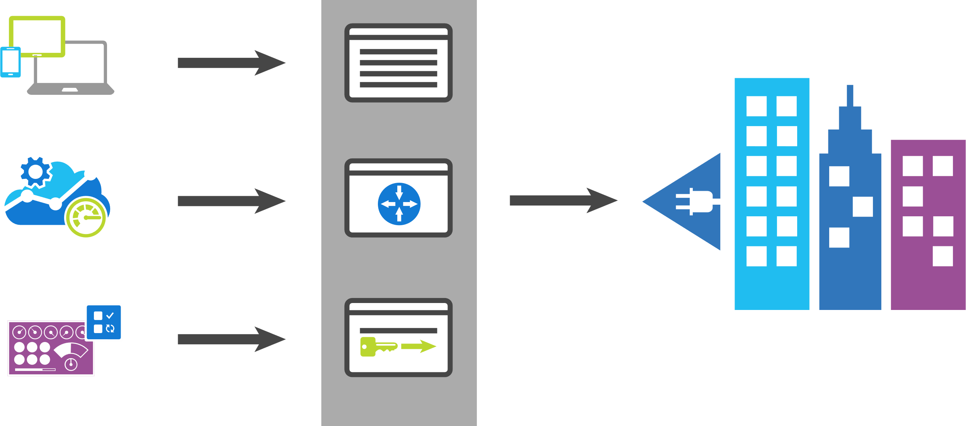
Key Features
Azure API Management
App developers
Developer portal
Direct or VPN
Apps
Gateway
Backend Services
Apps Publishers
Publisher portal
Notes:
Azure API Management fills all the roles of an API management platform, acting as an API Gateway, a Publisher Portal and a Developer Portal.
The API Gateway is the endpoint that accepts API calls and routes them to your backend services, making the necessary request and response transformations along the way. It’s responsible for enforcing security policies, usage quotas and rate limits, providing optimisations such as caching and for collecting and logging all the metadata on how the APIs are being used for reporting and analysis.
The Publisher Portal is the admin interface where you register and configure your APIs – defining or importing the schemas, packing APIs into products, setting up policies and managing users.
And the Developer Portal acts as the community site for your developers, where they can read API documentation, try out an API via the interactive console, create their account and subscribe to get API keys and access analytics on their own API usage.

Slide 10










API Management - a hub for enterprise APIs
Discover
Learn
On-board
Try
Get support
SDKs and samples
1st and 3rd party apps
Abstract
Secure & protect
Evolve
Monitor
Analyze
Productize
Monetize
Consume
Mediate
Publish
Developer portal
Gateway
Azure portal
API managers and developers
App developers
APIs on Azure and outside
Notes:
In the next few slides we’ll drill down on many of the capabilities of API Management. It’s important to understand that APIM has 3 major areas of capability:
There's a consumption side – the developer portal: Discover, learn, view code samples. Subscribe to API’s to access them.
Mediate- control access, abstract where the api's are, transform requests and responses to provide consistency.
Publish – create new API’s and expose them as “products” that developers can subscribe to. Version API’s.

Slide 11

Façade and front door
Gateway
Mediate
contoso.azure-api.net/foo
contosoapi-foo.azurewebsites.com
1st and 3rd party apps
api.contoso.com/foo
contosoapi-bar.azurewebsites.com
Notes:
Let's assume you have an API (at contosoapi-foo.azurewebsites.com). You can project it to developers by importing the swagger into APIM. This gives you An Exact replica at new URL (contoso.azure-api.net/foo)
You can also configure a custom domain name for your API (Api.contoso.com/foo)
Now you could change the back-end without the clients being aware.
You can make it behave differently through APIM policies. Restrict surface, change URL's, filter content.

Slide 12
Security and protection
Username/Password
Microsoft account
Google account
Facebook account
Twitter account
Azure AD (Premium)
Azure AD B2C (Premium)
Delegated
Developer portal
Consume
App developers
Key
OAuth 2
OpenID Connect
Client certificate
IP filter
Rate limits and quotas
Gateway
HTTP Basic
Mutual certificate
Shared secret
IP filter
VNET/NSG
Mediate
1st and 3rd party apps
Azure portal
Azure account
RBAC
Publish
APIs on Azure and outside
API managers and developers
Notes:
4 places where security matters to APIM.
Developer portal - many different types of
API Gateway - Authenticate and restrict acccess
API managers and developers
Secure channel beteween gateway and back-end. (Next slide will cover NSG/VNet in more detail)

Slide 13



VNETs and Hybrid
VPN
VNET
Gateway
Mediate
1st and 3rd party apps
Notes:
Suppose you have an API in an App Service Environment (isolated plan for App Service) but you want to expose it to the Internet.
You can expose it through APIM, by deploying APIM in a VNet (Premium and developer tiers)
There are 2 ways to deploy in a VNET:
With APIM exposing a public IP and proxying requests from Public Internet to a private VNET.
With APIM exposing only a private IP within a VNET and proxying entirely within the private network (e.g. from subnet to subnet). The case illustrated shows an application gateway exposing a public IP from the VNet and proxying requests to a completely private APIM.
In either case illustrated, NSG’s prevent direct access to the API and allow access to the APIM gateway so the gateway is the only way to access the API from the internet. In the second case, callers must go through the Azure App Gateway and then APIM.
Note that in either case, the back-end private IP address of APIM can make requests to anywhere the NSG’s allow it to send traffic.

Slide 14
Azure API Management Portal Concepts
Product 1
API A
visibility
Group
Operation 1
subscribe
User
Operation 2
API Z
Operation 3
Product N
Operation 4
Notes:
The publisher portal/Azure portal uses several abstractions that it’s important to understand:
An operation corresponds to a specific HTTP resource request (E.G. GET /Order/{X})
An API is a set of operations that are logically associated, usually (but not necessarily) because they come from the same back-end service.
A product is a set of API’s that are grouped together for visibility and policy reasons: You can define a policy that applies to a product. Products can be made visible in the developer portal to specific user groups and not others.
If a product is visible to a user (because of the group he or she is a member of) the user can subscribe to the product. Subscriptions can be automatically or manually approved.
When a user subscribes, he’s given an API key unique to his subscription.
APIM has its own user and group database, but can also leverage AAD users and groups for developer portal access.

Slide 15
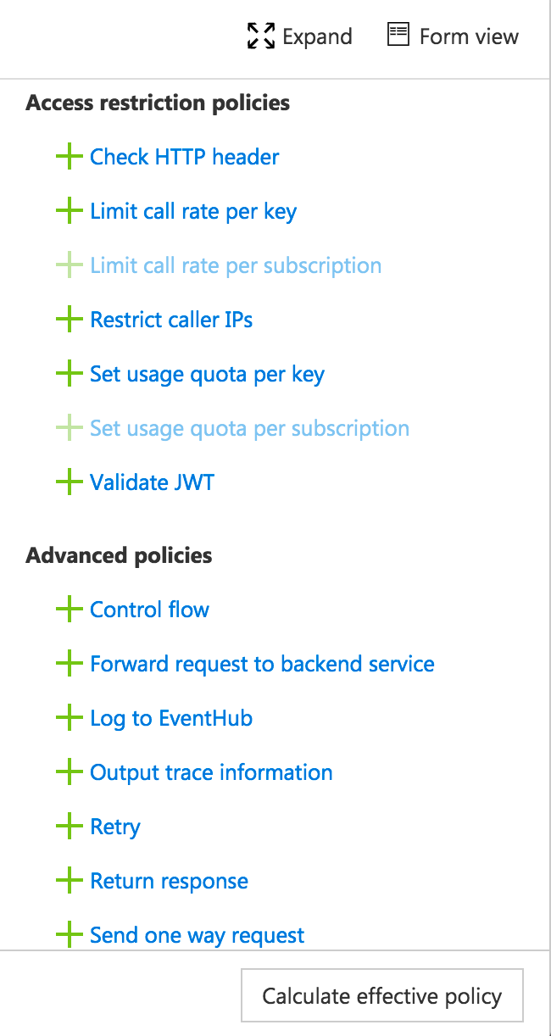
Policies
Encapsulate common API management functions
Access control, Protection, Transformation, Caching, …
Chained together into a pipeline
Mutate request context or change API behavior
Set in the inbound and outbound directions
Can be triggered on error
Applied at a variety of scopes

Slide 16
Access Restriction Policies
Check HTTP header
Limit call rate
by subscription and/or custom key
Restrict caller IPs
Call volume or bandwidth quota
by subscription and/or custom key
Validate JWT
Pre-authenticate for Oauth2 or OIDC back-ends

Slide 17
Transformation Policies
Convert between JSON and XML
Find and replace string in body
Rewrite URLs in content
Set backend service
Set body
Set HTTP header
Set query string parameter
Rewrite URL
Transform request or response XML using an XSLT

Slide 18
Some other policies
Set / Get variable
Conditional control flow
Log To Event Hub
Set Request Method
Authenticate to back-end with basic or client certificate
Store in Cache / Retrieve from cache
Send one-way request
(More)

Slide 19
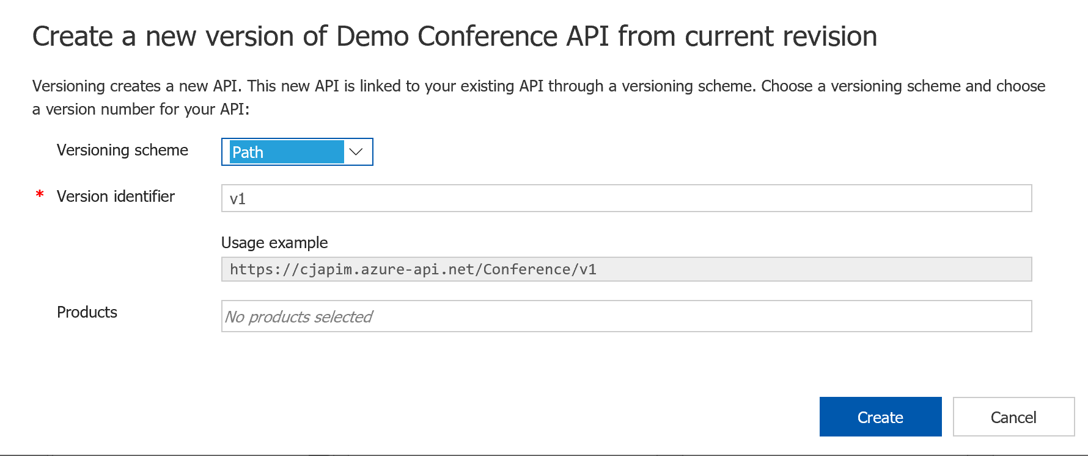
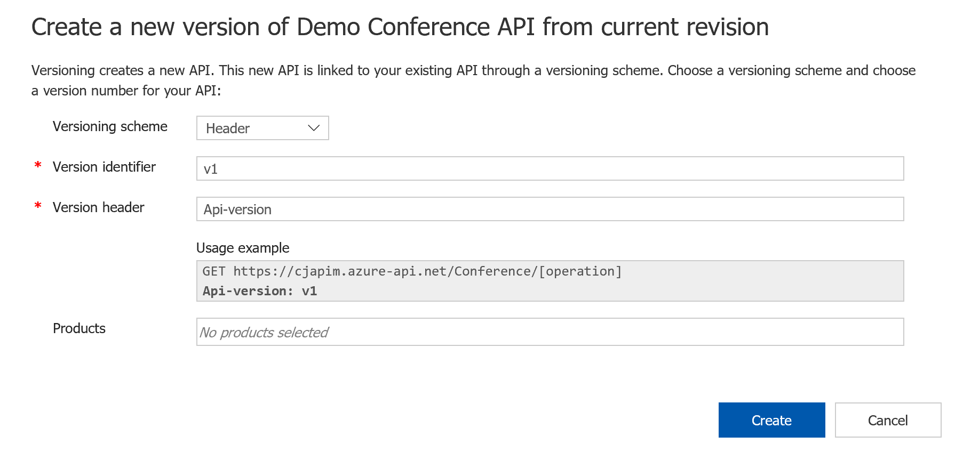
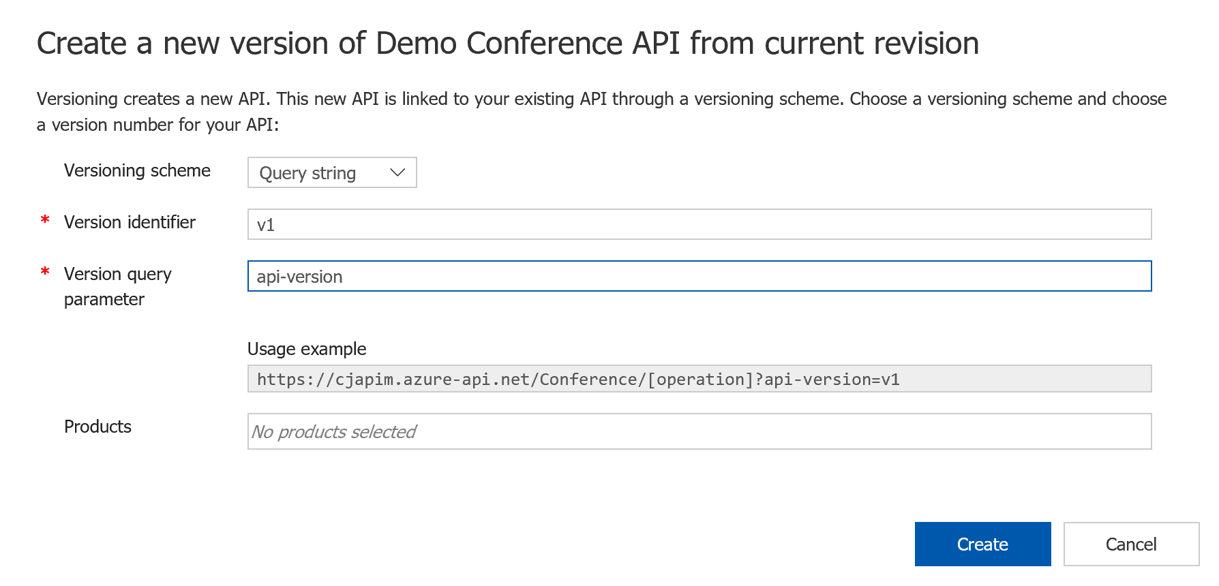
Approach to versioning
Natively understand versions at the system level
Versioning is an opt-in
Offer versioning scheme options
Inform developers about the changes
Control when the changes get adopted
Versions
Revisions
Consumers choose when to adopt
Providers choose when to deploy

Slide 20
Versions and revisions in API Management
Service Instance
API
Version
Revision
Operation
/v1
;rev=1
;rev=2
;rev=3
/speakers
/sessions
/days
https://example.org/
foo
;rev=4
/v2
;rev=1
;rev=2
Notes:
Revisions are for changes that are likely to be non-breaking, like adding a new operation. Users needn’t do anything special to use the current revision. When a revision is ready to be released, you just mark it “Current” and it starts being used.
Versions are a conscious choice on the part of consumers. Publishing a new version is likely to happen before users start calling it, so you can keep the prior version active as long as you still have users calling it as SOME users migrate to the new version in parallel.

Slide 21
Monitorability, tracing, analytics
Azure Monitor and Azure Activity log like any Azure service
Integrate with AppInsights (preview)
Requests
Dependency (back-end) calls
Integrate with OMS
Gateway Logs
Metrics
Log requests/responses/errors to Event Hub – via policy
Analytics in Publisher Portal
Power BI Solution template for APIM

Slide 22
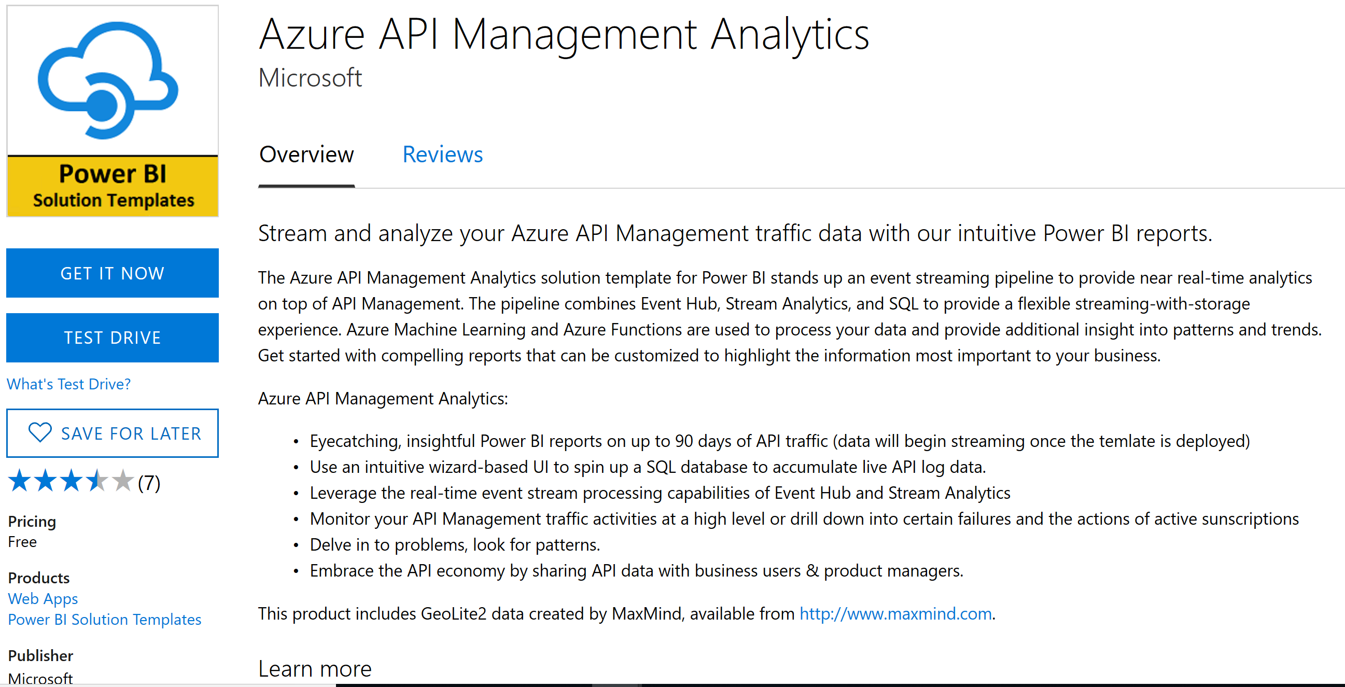
Azure API Management Analytics

Slide 23
Using API Management with Serverless
APIM
Logic App
Import Logic app into APIM
Import Logic app into APIM
HTTP Trigger
HTTP Trigger
Import Function app into APIM
APIM
Function
Import Function app into APIM
Generate Swagger, Edit
Generate Swagger, Edit
HTTP+Swagger action or trigger
(or custom connector)
Logic App
APIM
HTTP+Swagger action or trigger
(or custom connector)
Export Swagger from Developer portal and host it somewhere….
Export Swagger from Developer portal and host it somewhere….
Function
APIM
Code samples for several programming environments are automatically provided in developer portal….
Just make an HTTP request in code.
Just make an HTTP request in code.

Slide 24











Example scenarios
API Management
Virtual network or public
Logic Apps
SOAP web services
Backend
APIs
Logic Apps
Bot Framework
API Management
Functions
Notes:
How can you use APIM in a serverless architecture?

Slide 25

Multi-region and scaling
North Europe
Standard
1 unit
Notes:
Suppose we have an API in Europe….

Slide 26
Multi-region and scaling
North Europe
Standard
1 unit
3 units
Notes:
Scale – Just add more units
US clients can access the same endpoint- but they are exposed to higher latency

Slide 27
Multi-region and scaling
Central US
North Europe
1 unit
remote
Standard
Premium
1 unit
home
3 units
Native integration!
Notes:
Upgrade to Premium – and deploy a unit in another region. Local APIM caching helps improve performance.

Slide 28
Multi-region and scaling
Central US
North Europe
2 units
remote
Premium
1 unit
remote
1 unit
home
Native integration!
Notes:
Eventually add a US back-end- clients just see better performance without having to change the endpoint they access.

Slide 29










Advanced Analytics with API Management
Logic App
Machine Learning
SQL Database
Function
Event Hub
Stream Analytics
Power BI
Data Late Cluster
Data Lake Storage
Stream Analytics
JSON, XML, CSV...
<log-to-eventhub
logger-id=“id”
partition-key=“@(expression)”>
@{expression}
</log-to-eventhub>
BACKEND
SERVICES
AZURE API
MANAGEMENT
APPS
Notes:
With Azure APIM, you can log incoming and outgoing messages to eventhub. From there, you can do a wide variety of analytics on your API traffic. Later in this deck we’ll point you to a ready-made PowerBI solution that enables rich analysis and provides a sample of what is possible.
https://appsource.microsoft.com/en-us/product/web-apps/microsoft-powerbi.pbisolntemplate_apimanagement?tab=Overview
(Good idea to watch this 7-minute video before presenting the slide)

Slide 30
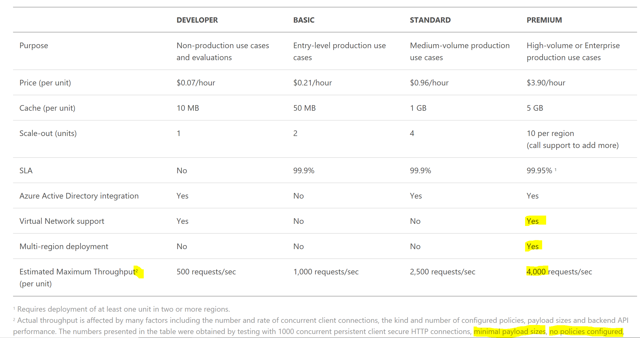
HA, scaling/capacity pricing details

Slide 31
Function Proxies vs API Management
 | Azure Functions Proxies | Azure API Management
Purpose | Define a single API surface for multiple function apps | Full life-cycle API management solution
Focus | Design and implement APIs with functions | Catalog, publish, transform, protect and monitor APIs hosted anywhere and implemented using any technology stack
Audience | API developers | Enterprise/Integration/Solution architects
Pricing | Consumption-based, starting with free | Monthly subscription, starting at $50/month
Features | API façade (REST) Basic request/response transforms API mocks | API façade (REST & SOAP) Full range of request/response transforms Policies and expressions Analytics Developer portal – catalog, documentation, samples, console API mocks Explicit Version and revision support
Scale up | APIs exposed by API Proxy managed by APIM | N/A

Slide 32
API Management
Demo

Slide 34
API Management roadmap
Summer-ish
Full support for ARM templates
Capacity metric in Azure Monitor
Release notification in Azure portal
Power BI solution template
Documentation improvements
Implementation guidance
Analytics in Azure portal
Fall-ish
“Enterprise API catalog”
Key Vault integration
App Insights integration
Payload validation
Improved policy authoring
Anomaly detection via ML
Open API Specification v3
China and US Government regions
Roadmap provides visibility into our current plans and estimates. It is not an official commitment.

Slide 35
Stay in touch
Questions, content, battle cards
http://aka.ms/askapim
Feature requests
http://aka.ms/apimwish
(The) Product roadmap
http://aka.ms/apimroadmap
Service updates (among other things)
http://aka.ms/apimblog
GitHub repo with sample policies
http://aka.ms/apimpolicyexamples
Hands-on walkthroughs
http://aka.ms/cadlabs
Documentation and references
http://aka.ms/apidocs

